Slide 1








PAMANTASAN NG LUNGSOD NG MUNTINLUPA University Road, Poblacion, Muntinlupa City
College of Information Technology and Computer Studies
BLOOD LINK: A MOBILE-BASED HYBRID BLOOD BANK FOR RED CROSS MUNTINLUPA CHAPTER
Program/ Section:
BSIT 3I
Adviser:
Ms. Kaycee R. Mendez, MIT, LPT
MARY GRACE S. SANTARIN
santarinmarygrace_act@plmun.edu.ph
JANREY CYRIL C. FADERANGA
faderangajanreycyril_act@plmun.edu.ph
KYRAH A. PANGILINAN
pangilinankyrah_act@plmun.edu.ph

Slide 2


Chapter 1- Introduction
PAMANTASAN NG LUNGSOD NG MUNTINLUPA University Road, Poblacion, Muntinlupa City
College of Information Technology and Computer Studies
Current Challenges: Traditional blood banking systems face challenges such as: Inefficient donor-recipient matching
Limited accessibility to donation centers
Lock of Information on Donation
Inconvenience on blood donation Inquiries
inefficient donor-recipient matching
Appointment Scheduling

Slide 3
Chapter 1- Purpose and Description
PAMANTASAN NG LUNGSOD NG MUNTINLUPA University Road, Poblacion, Muntinlupa City
College of Information Technology and Computer Studies
Purpose of the Study
To tackle the current inefficiencies in traditional blood banking, such as manual donor-recipient matching
lack of timely information

Slide 4
Chapter 1- Objectives of the Study
PAMANTASAN NG LUNGSOD NG MUNTINLUPA University Road, Poblacion, Muntinlupa City
College of Information Technology and Computer Studies
General Objective:
The main objective of this study is to develop Mobile-Based
Hybrid Blood Bank system.
Specific Objective:
To design the system using the following features
User login/register functionality.
Pre-screening health assessments.
Scheduling blood donation appointments.
User notifications

Slide 5
Chapter 1- Objectives of the Study
PAMANTASAN NG LUNGSOD NG MUNTINLUPA University Road, Poblacion, Muntinlupa City
College of Information Technology and Computer Studies
Real-time inventory updates.
Communication between donors and recipients.
Location services.
Educational resources.
Report generation.

Slide 6
Chapter 1- Objectives of the Study
PAMANTASAN NG LUNGSOD NG MUNTINLUPA University Road, Poblacion, Muntinlupa City
College of Information Technology and Computer Studies
To develop the system using React Native or JavaScript for mobile development, Nativewind CSS for styling, Node.js for the server, and MySQL for the database.
To test and improved the functionality of the system using Alpha and Beta Testing method.
To evaluate the performance of the system using ISO/ IEC 25010: 2011 Software Characteristics.
To implement the system to the Red Cross Muntinlupa Chapter.

Slide 7
Chapter 1- Scope and Limitation
PAMANTASAN NG LUNGSOD NG MUNTINLUPA University Road, Poblacion, Muntinlupa City
College of Information Technology and Computer Studies
SCOPE:
1. A mobile application interface for blood donors and recipients to interact with
the blood bank system.
2. Integration with centralized blood bank infrastructure
3. Location services

Slide 8
Chapter 1- Scope and Limitation
PAMANTASAN NG LUNGSOD NG MUNTINLUPA University Road, Poblacion, Muntinlupa City
College of Information Technology and Computer Studies
LIMITATION:
1. Focus on system development only.
2. Integration with external systems not included.
3. Not address challenges related to mobile device compatibility or internet connectivity.
4. No support for iOS devices, only Android 10 and above

Slide 9
Chapter 2- Review of Related Literatures & Studies
PAMANTASAN NG LUNGSOD NG MUNTINLUPA University Road, Poblacion, Muntinlupa City
College of Information Technology and Computer Studies
Topic Outline:
Related Studies 1
Related Studies 2
Related Studies 3
Related Studies 4
Related Studies 5

Slide 10
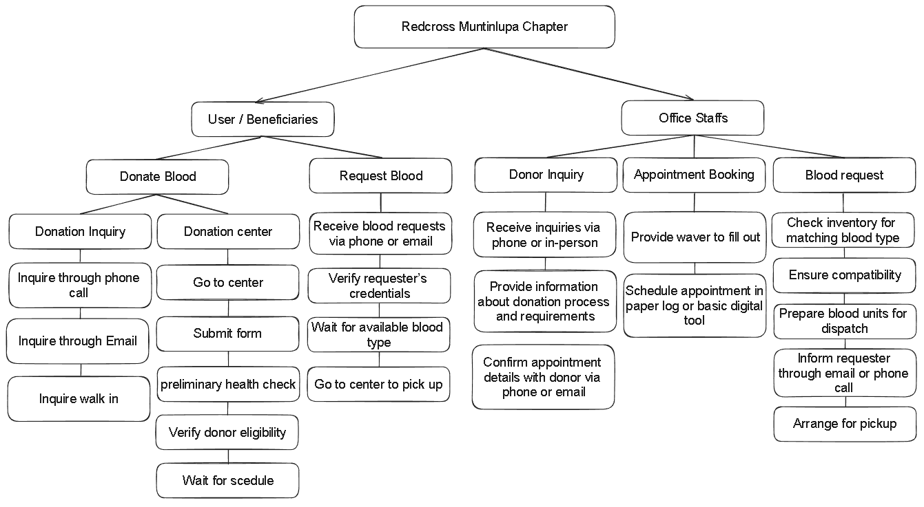
Chapter 3- Methodology
PAMANTASAN NG LUNGSOD NG MUNTINLUPA University Road, Poblacion, Muntinlupa City
College of Information Technology and Computer Studies
Requirements Analysis

Slide 11
Chapter 3- Methodology
PAMANTASAN NG LUNGSOD NG MUNTINLUPA University Road, Poblacion, Muntinlupa City
College of Information Technology and Computer Studies
Requirements Analysis (cont.)

Slide 12
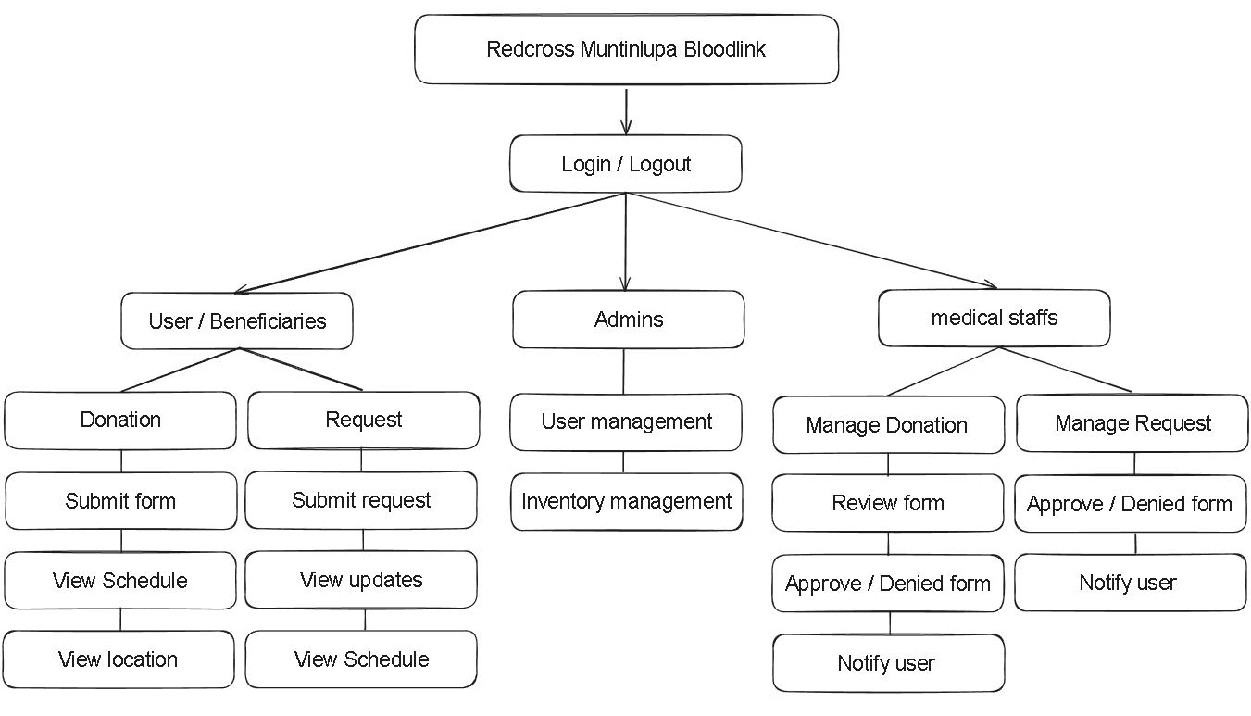
Chapter 3- Methodology
PAMANTASAN NG LUNGSOD NG MUNTINLUPA University Road, Poblacion, Muntinlupa City
College of Information Technology and Computer Studies
Requirements Documentation

Slide 13
Chapter 3- Methodology
PAMANTASAN NG LUNGSOD NG MUNTINLUPA University Road, Poblacion, Muntinlupa City
College of Information Technology and Computer Studies
Requirements Documentation (cont.)

Slide 14
Chapter 3- Methodology
PAMANTASAN NG LUNGSOD NG MUNTINLUPA University Road, Poblacion, Muntinlupa City
College of Information Technology and Computer Studies
Design of Software, Systems, Product and/ or Processes
Knowledge Requirements
- Database Management
- Mobile Development
- Backend Devepment and APIs
- Software tools
- Frontend Development and frameworks
- Mobile App Development platform Software Requirements
RAD Methodology
- Requirements Analysis and Planning
- Software Architecture and Design
- System Construction
- Cutoverthodology
- Requirements Analysis and Planning
- Software Architecture and Design
- System Construction
- Cutover
Blood Link: A Mobile-Based Hybrid Blood Bank For Red Cross Muntinlupa Chapter
- Visual Studio
- Git/Github
- JavaScript
- Node.js
- Expo Go
- MySql
- Nativewind
- ChatGPT
Hardware Requirements
- Computer
- Internet Connection
- Mobile Devices

Slide 15
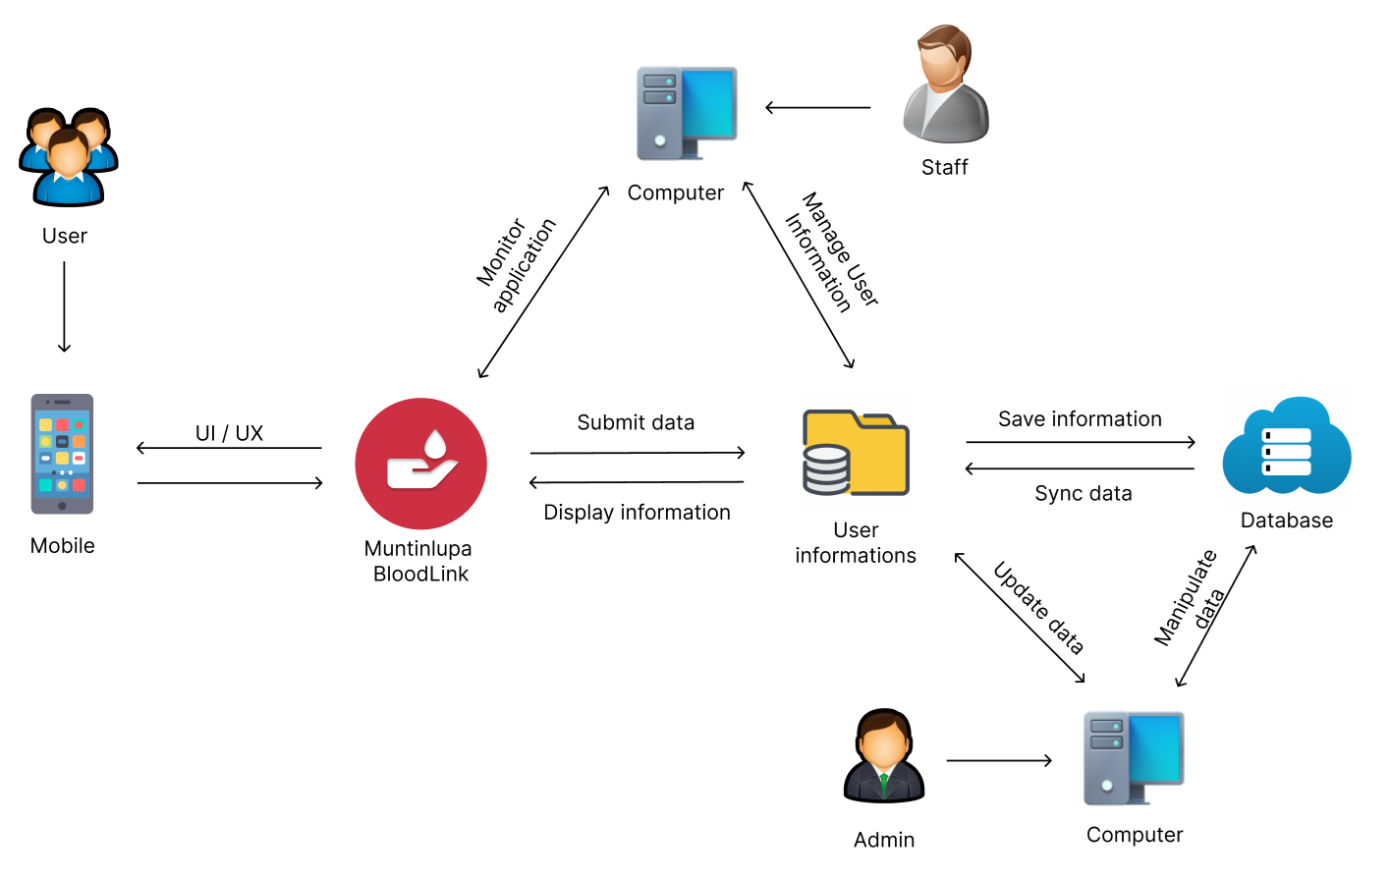
Chapter 3- Methodology
PAMANTASAN NG LUNGSOD NG MUNTINLUPA University Road, Poblacion, Muntinlupa City
College of Information Technology and Computer Studies
System Architectural Diagram

Slide 16
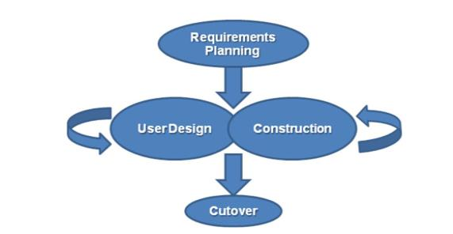
Chapter 3- Methodology
PAMANTASAN NG LUNGSOD NG MUNTINLUPA University Road, Poblacion, Muntinlupa City
College of Information Technology and Computer Studies
Project Development

Slide 17
Chapter 3- Methodology
PAMANTASAN NG LUNGSOD NG MUNTINLUPA University Road, Poblacion, Muntinlupa City
College of Information Technology and Computer Studies
Testing Procedures - Alpha Testing
Aspect | Alpha Testing
Purpose | Identify and fix bugs, enhance features, and ensure the system meets requirements
Participants | Developers, testers, and selected internal users
Scope | All major features including Database Connection
Focus Areas | Functionality, usability, performance, and security
Duration | Typically shorter, lasting a few week
Feedback | Collected from development team
Issue Resolution | Immediate and iterative, as issues are reported and fixed quickly
Output | Improved and more stable version of the system

Slide 18
Chapter 3- Methodology
PAMANTASAN NG LUNGSOD NG MUNTINLUPA University Road, Poblacion, Muntinlupa City
College of Information Technology and Computer Studies
Testing Procedures - Beta Testing
Aspect | Beta Testing
Purpose | Validate the system's performance, usability, and reliability in real-world scenarios
Participants | A broader group of actual end-users
Scope | Real-world usage of the system by actual users
Focus Areas | User experience, system performance, and overall reliability
Duration | Typically longer, lasting several weeks to months
Feedback | Collected from actual end-users
Issue Resolution | Issues are documented for post-beta fixes and improvements
Output | Final adjustments and fixes leading to the official release

Slide 19
Chapter 3- Methodology
PAMANTASAN NG LUNGSOD NG MUNTINLUPA University Road, Poblacion, Muntinlupa City
College of Information Technology and Computer Studies
Implementation Plan
Strategy | Activities | Persons Involved | Duration
Approval from the company | Send letters for the approval of Administrators | Researchers, Administrator | 1 – 2 Days
System Installation | Installation of the system and checking of the facility that needs an upgrade (software and hardware). | Researchers, Administrator | 2 - 3 Days
Information Distribution | Send Flyers, Brochures, Posters, and User Manual | Researchers, Administrator | 1 Day
3- Day Training | Hands-on Training and System Demo/ Lectures | Researchers, Adviser, Officer and Administrator | 3 Days

Slide 20
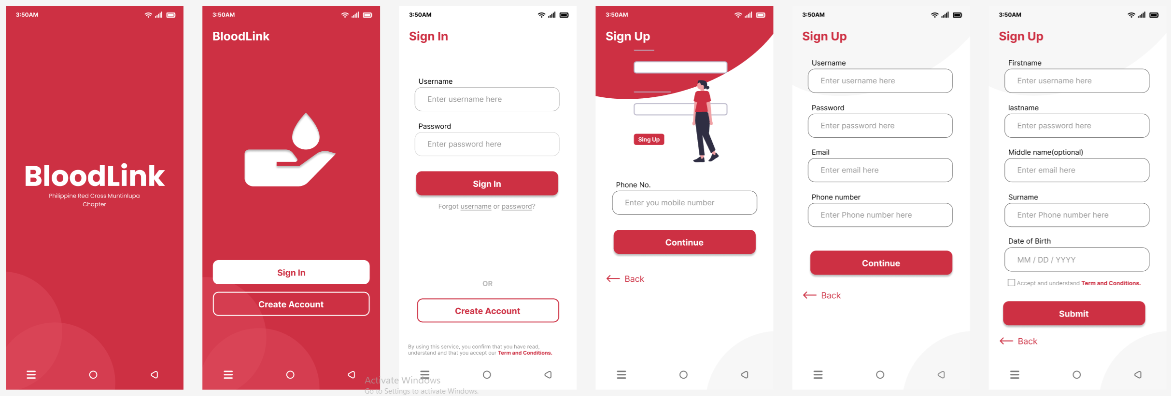
PROPOSED SYSTEM DESIGN
PAMANTASAN NG LUNGSOD NG MUNTINLUPA University Road, Poblacion, Muntinlupa City
College of Information Technology and Computer Studies

Slide 21
End Presentation
PAMANTASAN NG LUNGSOD NG MUNTINLUPA University Road, Poblacion, Muntinlupa City
College of Information Technology and Computer Studies
Thank You

